Slide 1
Welcome
“Soaring to New Heights”

Slide 2
HC DrugFree partners with the Howard County Public School System and Parent Teacher Associations to provide drug and alcohol resources to school staff, students, parents and the community. Together we can save lives.

Slide 3
Back to School Night
Lake Elkhorn Middle School
Notes:
[fill in on slide: school name, principal name]
Welcome
Introduce: principal, APs, etc.

Slide 4
Notes:
Lynnette

Slide 6
Your administrative team…
Lynnette Moore, Principal
Tiffany Carmean, Assistant Principal - 6th
Kelli Nitsch, Assistant Principal - 7th
Kevin Dorsey, Assistant Principal - 8th
Notes:
Lynnette

Slide 7
Show your Eagle PRIDE
P erseverance
R espect
I ntegrity
D ependability
E xcellence
Notes:
Lynnette

Slide 8
Lake Elkhorn Middle School
PBIS Discipline Ladder
1st Offense - Teacher Warning and Parental Contact
2nd Offense - Teacher Detention, Parental Contact and MIR
3rd Offense - PBIS Coordinator Conference, Parental Contact, School-wide detention assigned and MIR
4th Offense - PBIS Coordinator Conference, Parental Contact, and Friday School assigned; Office Referral
5th and Higher Offense - Administrator Assigned Consequence. See HCPSS Code of Conduct and LEMS Agenda Book; Office Referral
Notes:
Lynnette

Slide 9
Responsible Use of Technology and Social Media
Notes:
Communications technology, including social media, is a fact of modern life. Learning to use technology effectively and responsibly is an important part of every student’s education.
HCPSS continues to encourage responsible use of technology and social media among students and all community members. You’ll see messages like this one posted in schools. Additional communications and events for students and families explore this important topic.
Preventing cyberbullying is an important part of this effort. This is a growing problem affecting many students. All middle and high school agenda books include a page about Grace’s Law with tips for students to protect themselves and others. [see Grace’s Law handout]

Slide 10
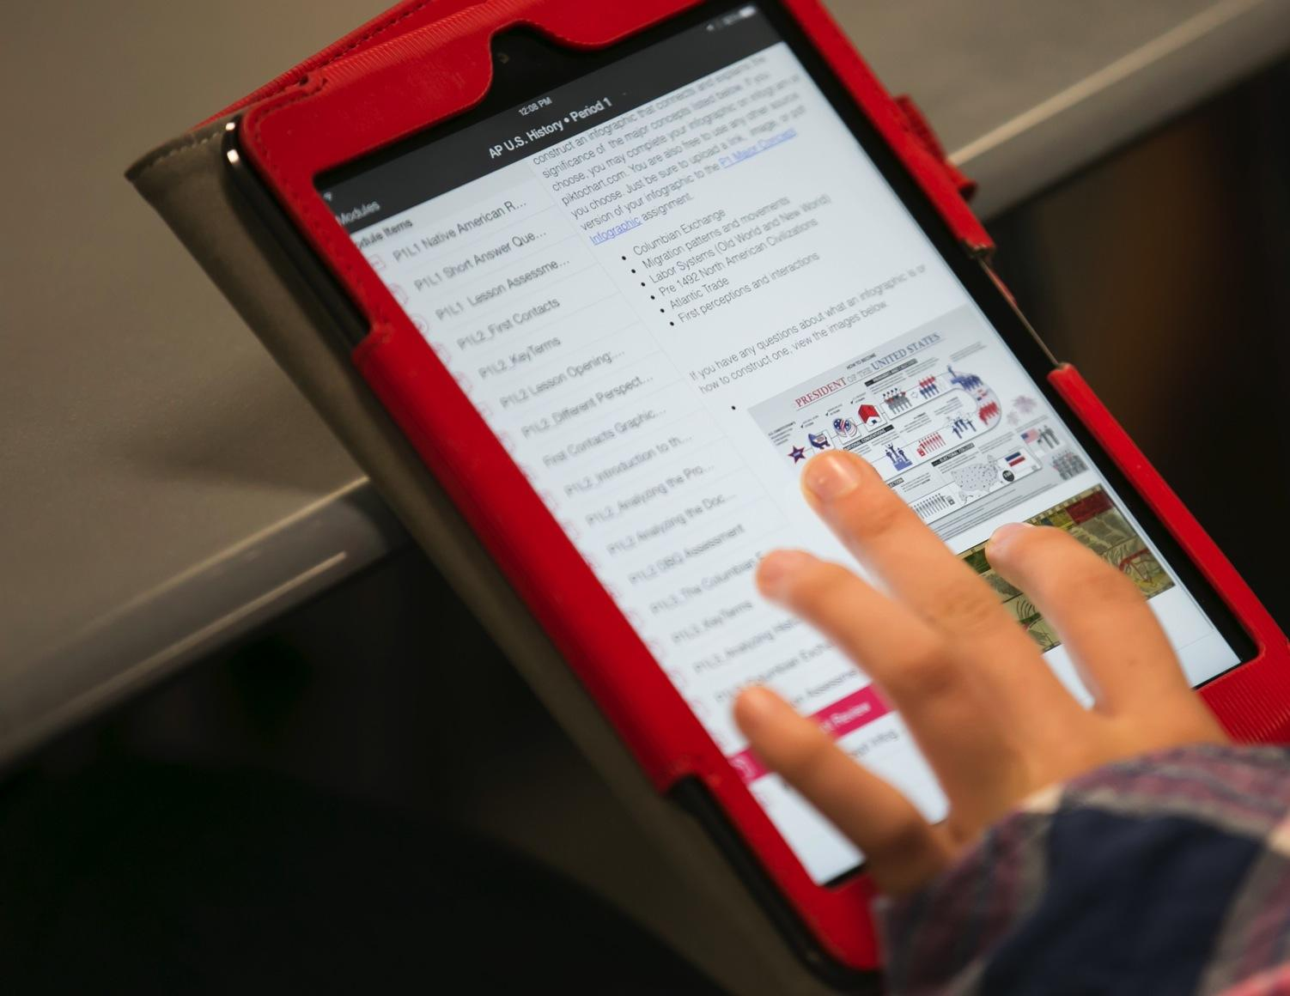
Notes:
The HCPSS is committed to providing a next-generation learning environment where every student has access to learning experiences and instruction designed around communication, collaboration, creativity, and critical thinking.
Bring your own device (BYOD) allows students in middle and high school to use their personal devices (phones or tablets) for teacher-sanctioned instructional activities. connect to the network to gain access to instructional resources, class projects, etc.
BYOD is OPTIONAL. Students are never required or expected to bring a personally-owned device to school. When an instructional activity is planned that needs access to individual technology, devices will be provided for use for students who do not have their own technology.
Use of Personal Devices in school for non-instructional activities:
Middle school students may carry their personal communication devices with them during the school day. Devices must be TURNED OFF or silent at all times during school hours.
Devices may not disrupt instructional activities and should be put away (in pocket, backpack, or locker). Students may use their devices before and after school, during lunch, and during hallway transition times.
Note: To clarify a common misperception: There are NO PLANS to introduce BYOD at the elementary level.
More information is available online at www.hcpss.org/byod and in the Student Parent Handbook.

Slide 11
Transportation
Notes:
Kevin
Transportation

Slide 12
School News and Information
Email
Print
Social Media
Video
In Person
Notes:
Kevin
School Communications – OVERVIEW
Engaging parents and families as partners in education is one of the highest priorities of our school system and school. We use several communications tools to keep parents informed of what’s happening in the school and provide the information you need to make informed decisions regarding your child’s education. I’ll describe each of these in a moment [covered on following slides].
Often – personal communications are best.
Most important is that you feel comfortable reaching out to teachers and administrators whenever you have a concern or question. We’re happy to meet with parents or have you visit the classroom. Please call the school office with questions or to set up a convenient time. We also value parent involvement in school activities.
Feel free to contact any teacher or administrator via Email, or make an appointment to meet to discuss your concerns.

Slide 13
HCPSS System and School News
Email
Text
School News
HCPSS News
Emergency Notices
Optional for
Emergency Notices
Only
Details: www.hcpss.org/hcpss-news/
Notes:
Kevin
Parents receive news and announcements from our school and from the school system via the HCPSS News service.
Parents are automatically registered for this service. Email messages are delivered to the contact information that you provide in the Family File.
You will receive via email:
School newsletters & other communications
System-level announcements
Emergency notifications (school closings/delays).
Text messages: Parents are given the option to receive text messages. Text messages are sent only for urgent/emergency announcements (school closings and delays, etc.)
New parents are sent a text message to opt-in for text alerts. – if you didn’t receive this, visit www.hcpss.org/hcpss-news/ to troubleshoot.
Text alerts are sent to the mobile phone number identified in the Family File.
If you were already opted-in to receive text messages last year, and your phone number has not changed, you do not need to opt-in again.
Community members and others can sign up to receive email and/or text messages at www.hcpss.com/hcpss-news (or visit the home page www.hcpss.org and click on the link at the bottom of the page).

Slide 14
School Closings/Delays
www.HCPSS.org
HCPSS News
@hcpss
HCPSS TV
HoCoSchools
Verizon 42
Comcast 72
Notes:
Kevin
School Delays and Closings (usually weather-related) are communicated through several channels:
HCPSS homepage: www.hcpss.org - this is the first and most complete source of information
HCPSS News emails and texts (as described on previous slide)
Social media: Twitter & Facebook
HCPSS TV – channel 42 (Verizon) and 72 (Comcast)

Slide 15
Social Media
[Lake Elkhorn] Twitter: @hcpss_lems
HCPSS Facebook:
www.Facebook.com/HoCoSchools
HCPSS Twitter: www.Twitter.com/HCPSS
HCPSS Flickr: flickr.com/photos/hcpss
HCPSS Instagram: instagram.com/hocoschools
Interact with the Superintendent:
Twitter: https://twitter.com/mjmsuper
Blog: superintendent.hcpss.org
Notes:
Kevin
[
Link to our social media sites:
Get up-to-the-minute updates, news, student and school happenings, and announcements
Interact with the school and system

Slide 16
Mobile App
Notes:
Kevin
The HCPSS Mobile App is available free to download for iphones, iPad, and Android devices in the app stores (search for “HCPSS”).
The app makes it quick and easy to find the information you need, when you need it. It provides:
Simplified access to information
On-the-go access and quick links
Compiles messages and calendar dates from all of the schools that your children attend, as well as school district information.

Slide 17
SYNERGY STUDENT
INFORMATION
SYSTEM
CANVAS
LEARNING
SYSTEM
FAMILY FILE
www.hcpss.org/connect
Notes:
Kevin
HCPSS Connect is the one-stop portal to access Synergy, Canvas, and the Family File.
The Synergy Student Information is your source for official student records & grades.
The Canvas Learning System gives teachers, parents, and students tools to communicate, collaborate, and connect.
Both systems are extremely easy to learn and to use.
Find full details and instructions online at www.hcpss.org/connect
Benefits of HCPSS Connect for Parents, Students & Teachers:
Improved communication and collaboration
All schools and grades use the same digital platform
Single sign-on – each user has one login/password via HCPSS Connect
Anytime/anywhere across multiple devices

Slide 18
Parent contact information
Medical data and contacts
Afterschool transportation
Data privacy preferences
www.hcpss.org/connect
Notes:
Tiffany
The Family File on HCPSS Connect provides important information about your student. All information is confidential.
It is important that parents update the Family File with current data about your student including:
Parent emails and phone numbers
Student medical contact data
Afterschool transportation options
Data privacy options
Log into HCPSS Connect and click the My Account tab. Save your changes by clicking the Update Account button.
Family File remains open throughout the school year, so you can make changes at any time they occur.
Parents without online access can provide this information through a paper “Emergency Procedure and Confidential Student Information” form. Contact the school office for a copy of this form.

Slide 19
Attendance
HCPSS Attendance Policy #9010
Being Present and ready for instruction……
Notes:
Tiffany

Slide 20
What does “on time to school” mean?
On time to school means inside your 1st period classroom when the late bell rings...Not in the hallway or bathroom.
If you are tardy to school
1st & 2nd late arrival Warning 3rd & 4th late arrival Administrative Lunch Detention 5th late arrival AM Detention 6th late arrival Friday Evening School

Slide 21
What to Expect: 2017-2018 School Year
Teacher Homepage
Student Privacy Information
Course information
Calendar due dates
Calendar test dates
CANVAS
Assignment details
Student skill building (grade appropriate)
mobile app
Notes:
Tiffany
CANVAS EXPECTATIONS and Growth plans for teachers for the 2017-2018 school year:
This year all teachers will be posting information in Canvas that parents can access through HCPSS Connect or the Canvas Parent Mobile App for iOS or Android.
Teachers are expected to maintain:
Teacher Homepage
Student Privacy Information - Information on homepage regarding teachers’ use of recording devices and digital tools for school-related activities
Course information
Calendar due dates - Long term project due dates on the day they are assigned
Calendar test dates - Post test dates on the Canvas calendar 3 school days in advance
Assignment details - Include details such as directions, materials, links, resources, etc. as appropriate
In addition, teachers will be helping students develop their canvas / online learning skills with grade appropriate activities.

Slide 22
Getting Help
Login Assistance:
Contact School Office
Guides and Resources:
HCPSS Connect Homepage
Notes:
Tiffany
Parents will continue to use the same log in credentials as in prior years.
Parents of students new to HCPSS will receive their login information via US Mail.
For help with your login or password: call the School Office
For help in using Canvas, Synergy, or the Family File, see the many guides and resources on the HCPSS Connect homepage (www.hcpss.org/connect), or contact the school office.

Slide 23
College and career readiness program
24/7 access
7500 colleges
Career interests and strengths
Video interviews with industry leaders
4-year high school planning
Video overview: “Intro to Naviance” on YouTube
Notes:
Tiffany
Aqua box links to the Intro to Naviance video (2.2 minutes) – Click on box to show video during presentation if desired
Naviance is a college and career readiness program that connects student achievement with post-secondary planning. Naviance can greatly help each and every student in this school system.
Naviance is accessible 24/7 by students, parents and teachers to:
Search through thousands of colleges by interest area and other parameters
Watch video interviews with industry leaders in career fields of interest.
Develop a 4-year high school academic plan.
Take Individualized assessments to better understand career interests, learning styles, and personal strengths.
See a short video overview – search on YouTube for “Intro to Naviance” [click on aqua box on slide to view]
link: https://www.youtube.com/watch?v=7wv5Oea3Fg8
(The Naviance handouts provide more information.)

Slide 24
PARCC Assessment
Notes:
Kelli
Partnership for Assessment of Readiness for College and Careers (PARCC) is the name for the standardized reading, writing and mathematics assessments implemented in all Maryland schools. PARCC assessments are directly aligned to the Common Core standards.
PARCC replaced the Maryland School Assessment (MSA) for math and reading/English language arts and the High School Assessments in English 10 and Algebra I.
PARCC benefits:
Indicates how closely students, beginning in Grade 3, are on track to graduate college- and career-ready.
Gives teachers regular results to guide learning and instruction.
Provides data that can be compared across school districts and states.
Scoring:
The PARCC assessments are on a 5 point scale:
1=Did not yet meet expectations
2=Partially met expectations
3=Approached expectations
4=Met Expectations
5=Exceeded expectations
In grades 3-8, ratings of 4-5 indicate students are academically well-prepared to engage successfully in further study.
In high school courses, a 4-5 indicates students are on track to graduate prepared for colleges and careers. In future years, 4-5 will be used by in-state community colleges for placement in credit bearing courses.
Students hand-carry results home in the first few weeks of the following school year.

Slide 25
Measures of Academic Progress (MAP)
Notes:
Kelli
MAP (Measures of Academic Progress) is an online test used in Grades 1-8.
MAP allows us to assess where a student is performing, and how they’ve grown in achievement. All HCPSS Elementary and Middle schools participate in MAP.
MAP gives teachers timely feedback on student progress that they can use to adjust instruction effectively.
MAP provides many advantages:
Assesses proficiency in Math and Language usage in addition to Reading.
Computer-adaptive – i.e. the questions adapt in real-time to the student’s proficiency level. This appeals to students, because it isn’t a typical “mastery” test.
Provides quick, actionable feedback to teachers.
Directly aligned to Common Core standards.
Provides information on a student’s year to year growth.
Takes less time than the previous HCPSS quarterly assessments.
Students hand-carry results home a few weeks after the testing window ends.
For the 2017-2018 school year, students will take MAP once in the Fall. (The Spring MAP has been eliminated for grades 3-8).

Slide 26
Maryland Integrated Science Assessment (MISA)
Aligned to Next Generation Science Standards (NGSS)
Earth/Space science
Life science (biology)
Physical science (chemistry and physics)
More information: nextgenscience.org
Notes:
Kelli
MISA (Maryland Integrated Science Assessment) is the standardized science assessment, developed and implemented by the Maryland State Department of Education (MSDE).
MISA is an online test and, like our science curriculum, is aligned to the Next Generation Science Standards (NGSS). MISA covers all science disciplines: Earth/Space science, Life Science, Physical Science, and Engineering.
The Next Generation Science Standards (NGSS) are critical for all students, beginning as early as prekindergarten. The NGSS provide consistency in science instruction while connecting tightly with mathematics and English Language Arts.
Students cannot simply read about science in order to learn science – they must do science. In an NGSS science classroom, students operate as student scientists under the skillful facilitation of their teacher. Participation in science enables students to apply their mathematics learning, and to read and communicate using evidence.
Our goal is to ensure students are scientifically literate, rather than teaching them to pass a standardized test. Thus, the MISA test is not aligned to any unit of study or specific content to memorize.
Middle school students take the MISA in 8th grade.

Slide 27
Interactive School Menus
Food descriptions
Nutrition and allergens
Carb counts
Pre-payment links
Menus
Breakfast and lunch
http://hcpss.nutrislice.com
free iPhone or IOS app
HCPSS Mobile App
Notes:
Kelli
HCPSS offers online school menus through a website and mobile app by Nutrislice.
The interactive menus provide access to up-to-the-minute content anytime, anywhere.
The innovative school menu site features nutrition and allergen information for all Howard County school meal items, both breakfast and lunch, and includes:
Carb counts
Allergen filters
Food descriptions and photos
Menu item rating system
Links to MySchoolBucks pre-payment options
Monthly menu email subscription sign-up
And more
Menus are available in several languages: English, Spanish, Korean, Chinese, and French.
Options for using the interactive menus:
Online: hcpss.nutrislice.com
Download the free app, “School Lunch by Nutrislice,” in the Google Play or App stores.
Select the “Menus” icon on the HCPSS mobile app

Slide 28
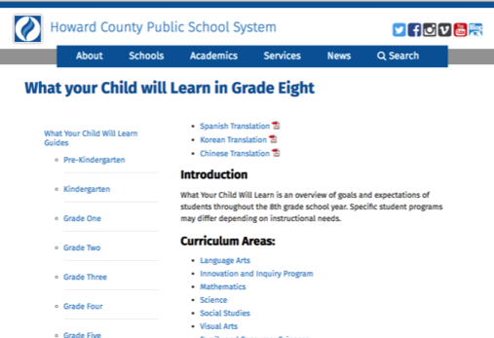
What Your Child Will Learn Guides
www.hcpss.org/academics
Notes:
Kelli
What Your Child Will Learn guides provide an overview of the instructional program for your child’s grade, as well as student goals and expectations. The guides include information to help parents monitor and support their child’s progress during the school year.
Individual guides are provided for each grade level. The guide identifies the content covered in each curriculum area, categorized by subject, e.g., Language Arts, Science, etc.
Find the middle and high school guides online at: www.hcpss.org/academics.
The guides are available online only; print versions are no longer distributed. Specific guide webpages may be printed from the website.
The guides provide general information about content covered in each curriculum area. Specific student programs may differ, depending on instructional needs.

Slide 31
Please ask…
•If you have a question or don’t understand something discussed, please ask.
•If we have a meeting scheduled and you would like to reschedule, or conference by phone, just ask.
•If you need additional time to make a decision, just let us know.

Slide 32
Special Education
•For specific questions, please contact Debbie Bates, Special Education ITL:
• deborah_bates@hcpss.org
• 410-313-7600
My Canvas page has a link to FAQs for special education

Slide 33
Thanks for Your Support
We are “Soaring to New Heights”
Don’t forget Picture Day is tomorrow

