Slide 1
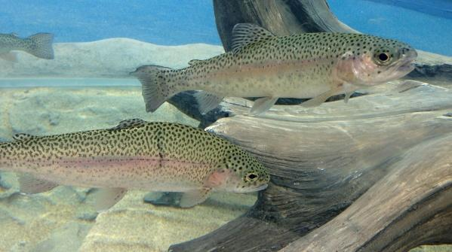
Trout Stages

Slide 2
The Embryo Stage
Fertilized eggs have black eyes and a central line that shows healthy development.
All the eggs hatch over a 2-3 day period from the first one hatches. Hatching usually starts within a week of egg arrival.
During this stage some eggs will not hatch properly. Any eggs that look fully opaque or have white or opaque spots will not develop and should be removed.
(should be removed when seen, or twice a day when possible with a turkey baster)

Slide 3
Alevin (Swim-up) Stage (4-6 weeks)
Yolk sacs disappear; trout start to wim up to the top of the basket.
Begin feeding first trout that swim up by spreading a very small amount of food near any swimming trout.
When all trout have started swimming up and feeding, gently start to lower basket towards the bottom of the tank.
The stronger trout will start to swim out into the tank but the weaker will stay inside the basket until they are strong enough to swim out into the tank.
Keep adding Special Blend and Nite-Out II to the tank once a week.

Slide 4
Alevin (Sac-fry) Stage (from hatching to 4 weeks)
After eggs hatch they have yolk-sacs they feed from this is called The Alevin Stage. Each alevin slowly begins to develop adult trout characteristics.
Tank maintenance is simpler when the alevin are in the breeder box. The longer the alevin can stay in the breeder basket the longer the hatchlings have time to learn to swim to the surface to feed.
During this stage odd looking trout (two-headed, three-headed) form, though in most cases don't survive.
Alevin can survive in a petri dish for short periods and can be observed closely under a microscope or by using a hand lens.
Notes:
hi

Slide 5
Fry Stage (6-8 weeks)
Some Trout never learn to feed and will die.
These non-feeding fish are called “pinheads”. (big heads, little bodies)
Pinheads should be removed because they will not develop.
Most T.I.C see a mortality spike with pinheads, they should not be alarmed because it is normal.

Slide 6
The Parr Stage (the time until release)
When a fry grows 2-5 inches it now becomes a fingerling
Larger fingerlings will develop large dark vertical stripes, known as “parr marks” (which can be used as camouflage)
Cannibalism can and does occur
If cannibalism occurs often, feed more often to assure hunger.
Large predatory fish can be separated and given time out by placing them in the breeder basket.

